Slide 1

WEEK 4
04th SEPTEMBER–
08th SEPTEMBER
RUT CHOLERA
EMP CODE: 655095

Slide 2
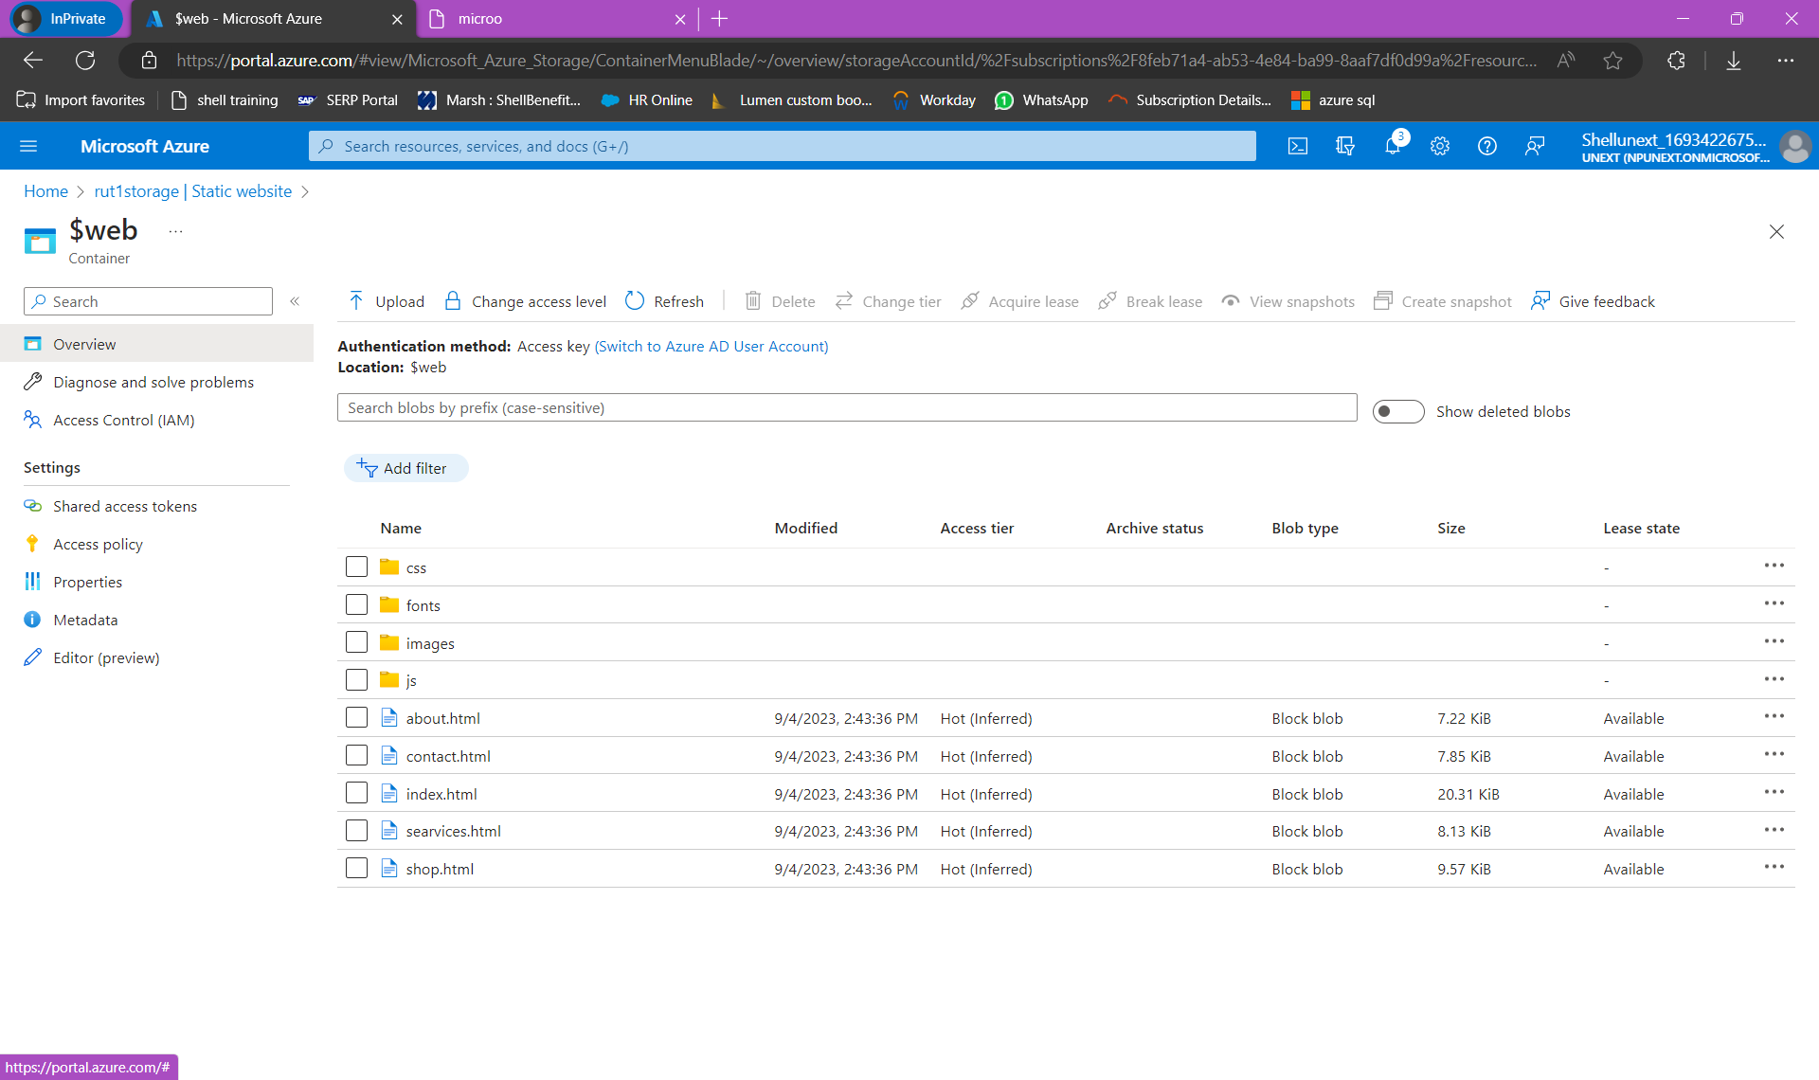
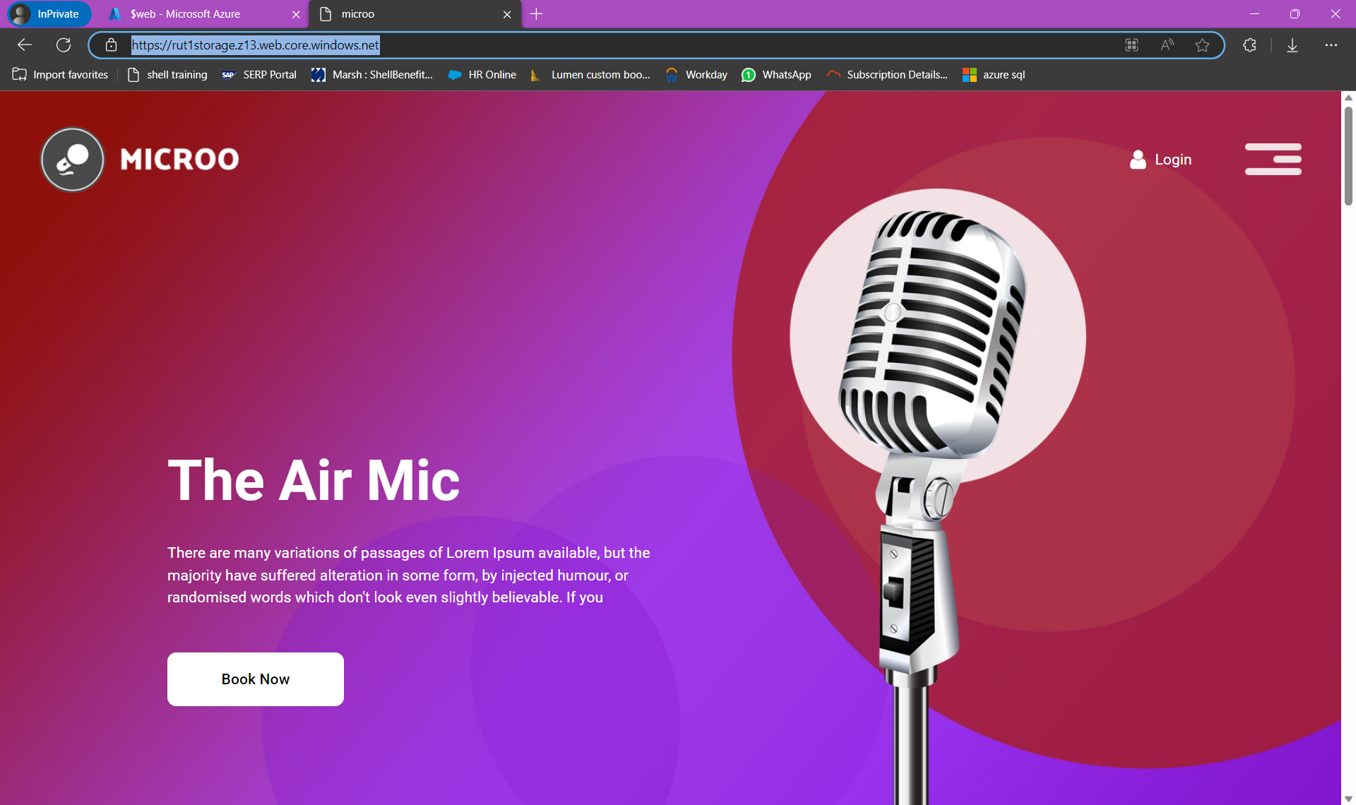
04th September
We learnt about azure cloud storage
We can use it to store messages for online social media app
We created container and uploaded text files on it
We hosted a static website on the container

Slide 3
05th September
Learnt about types of redundant storages like LRS,GRS,ZRS
Created containers
File Sharing
Queues, tables
Hot tier, Cold tier

Slide 4
06th September
Create a Linked Services
If, for each, until, title Condition Activity
Web Activity

Slide 5
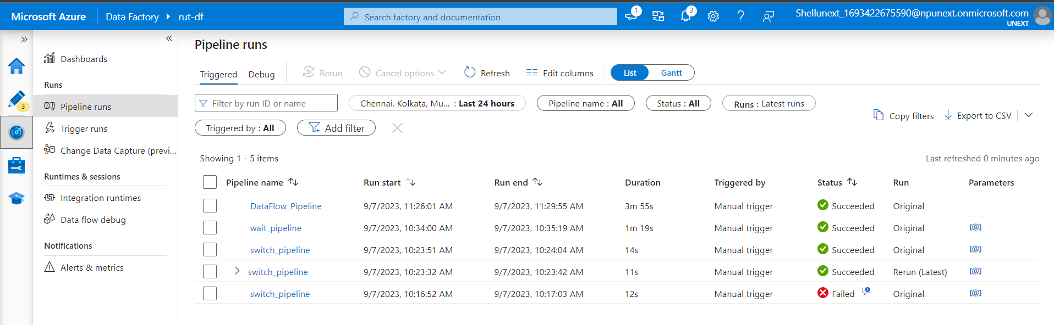
07th September
Created multiple dataflows, pipelines and executed them
Aggregate dataflows. Below shows all the triggered pipelines

Slide 6
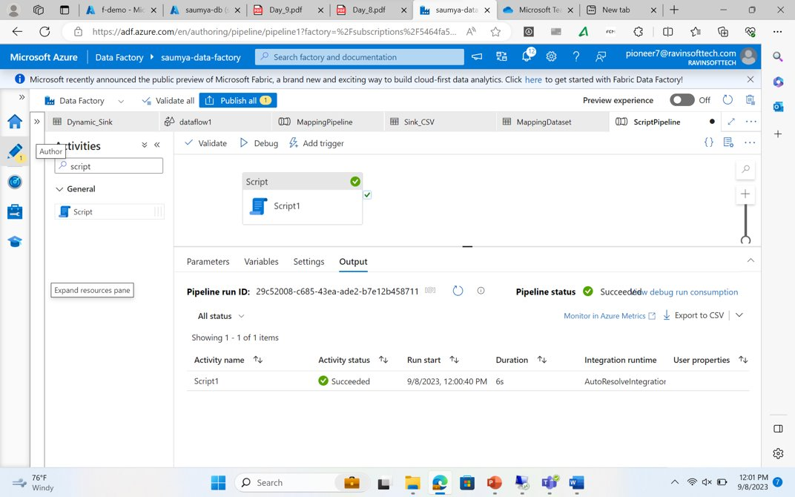
08th september
CDC(change data capture)
CDC Real-Time and hands on experience
Condition Logic
Case study where we learnt to delete all the files less than a particular size in the folder using data factory pipelines

Slide 7
THANK YOU

